Slide 1
LIGHTFAIR INTERNATIONAL 2019
Post-Game Show
Presented by
Lighting Design Lab’s Staff
June 13th, 2019

Slide 2
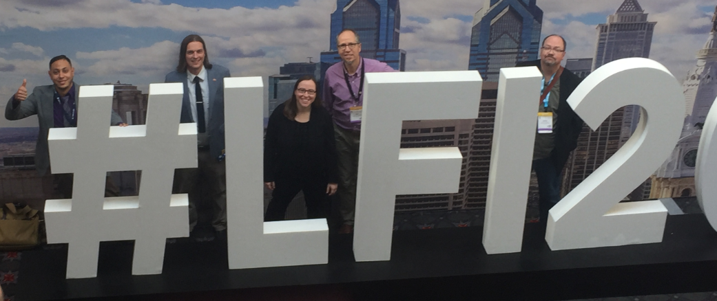
Stand By for Presentation

Slide 3
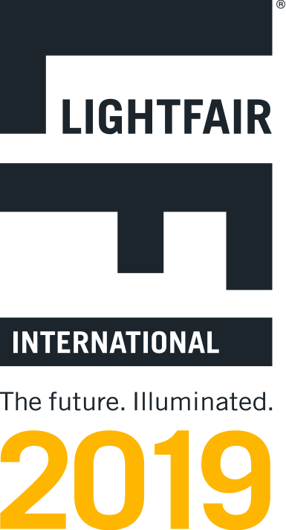
2019 LightFair International Post-Game Show
Welcome
Courses Offered
Lab’s NLC 2-day Workshop
Trends from LFI
Innovation Awards
Industry engagement
Staff’s Favorites
The Lighting Design Lab does not recommend or endorse any specific product or brand and any reference to products or brands is purely for demonstrative purposes
Notes:
Trends
Include emerging tech in trends
Developing projects -> drafting software for reports, lutrons estimating software

Slide 4
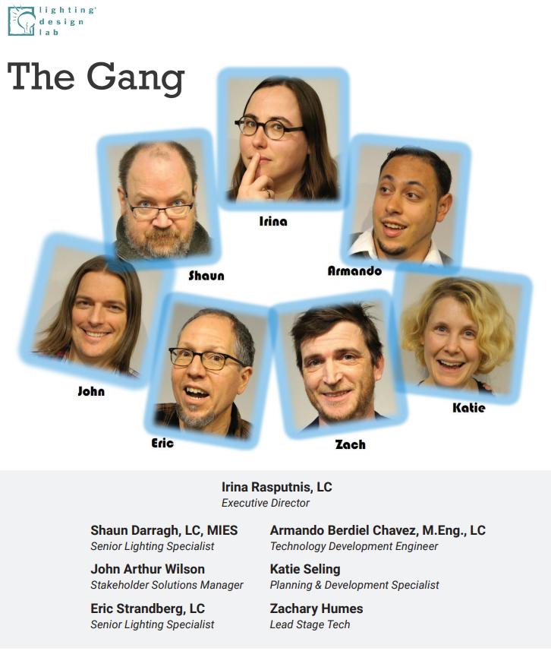
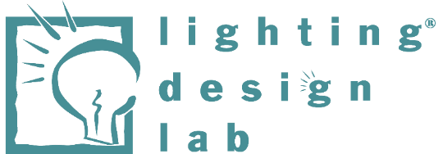

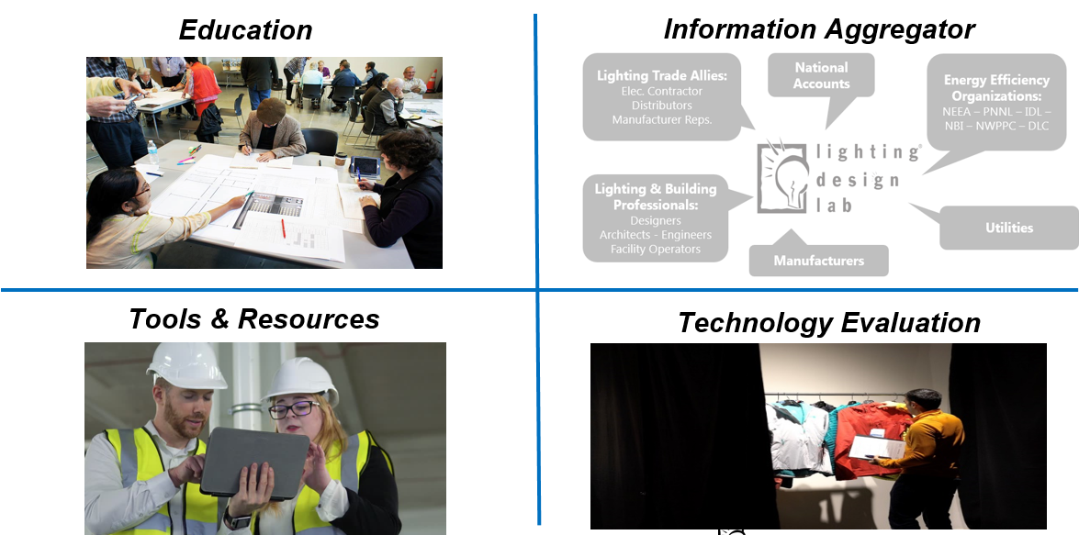
Welcome: Lighting Design Lab 2019 and Beyond
Industry Partners
Utility Stakeholders
Notes:
4 core
- One line each
Scl logo
Funded by utilities / industry

Slide 5
Smart Buildings Center
Mission
To accelerate the adoption and commercialization of smart building technologies and practices through education and demonstration.
Vision
Smarter use of technology and practices in the built environment, particularly as they relate to building operations and management, will enable a cleaner, healthier and more productive future.
Pillars of activity
Delivering training programs to educate the building workforce of the future; enabling industry leading demonstration projects; and connecting the industry through hosting and participating in smart building events.

Slide 6
Smart Buildings Center Programs
Building Operator Certification
Tool Lending Library
The leading training and certification program for building engineers and maintenance personnel.
Graduates make their buildings more comfortable, efficient and environmentally friendly, thanks to skills they master in our classes.
The BOC credential is just as valuable to building owners as it is to operators.
Our graduates help their organizations substantially cut operating costs – as much as $20,000 per year.
The SBC hosts a lending “library” of diagnostic tools available to building owners and managers, as well as energy service professionals.
The SBC can help by loaning a range of data loggers, power meters, lighting loggers, infrared cameras, liquid and air flow measurement devices, and much more.
Users can access these tools free of charge for prescribed time periods and capture data on system performance.
Analyzing these data can troubleshoot performance problems and create actionable information that can fine-tune building performance.

Slide 7
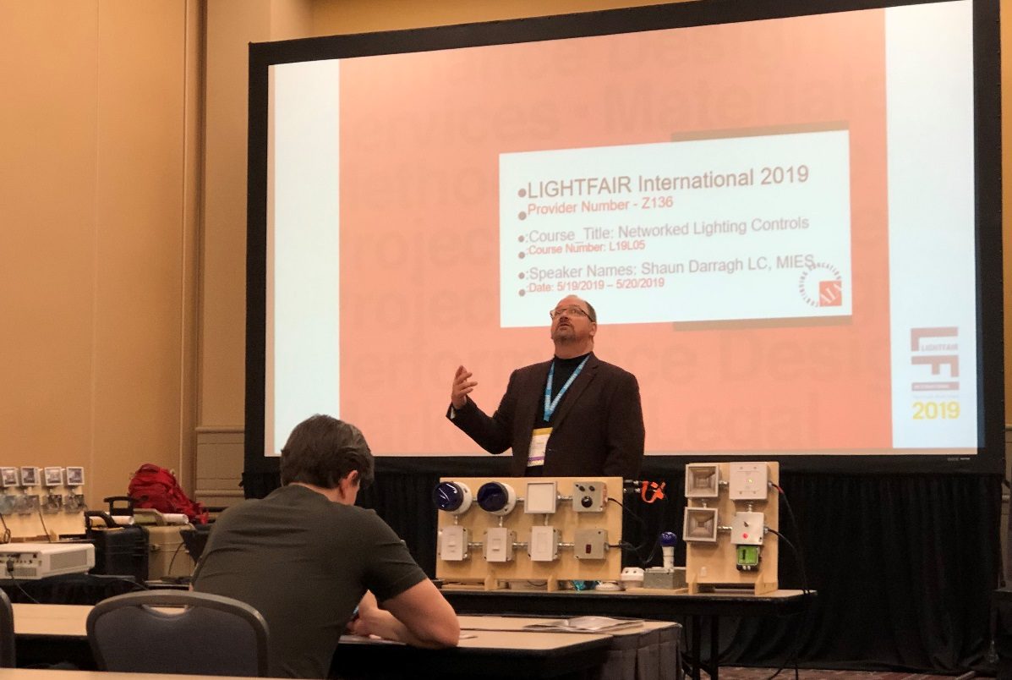
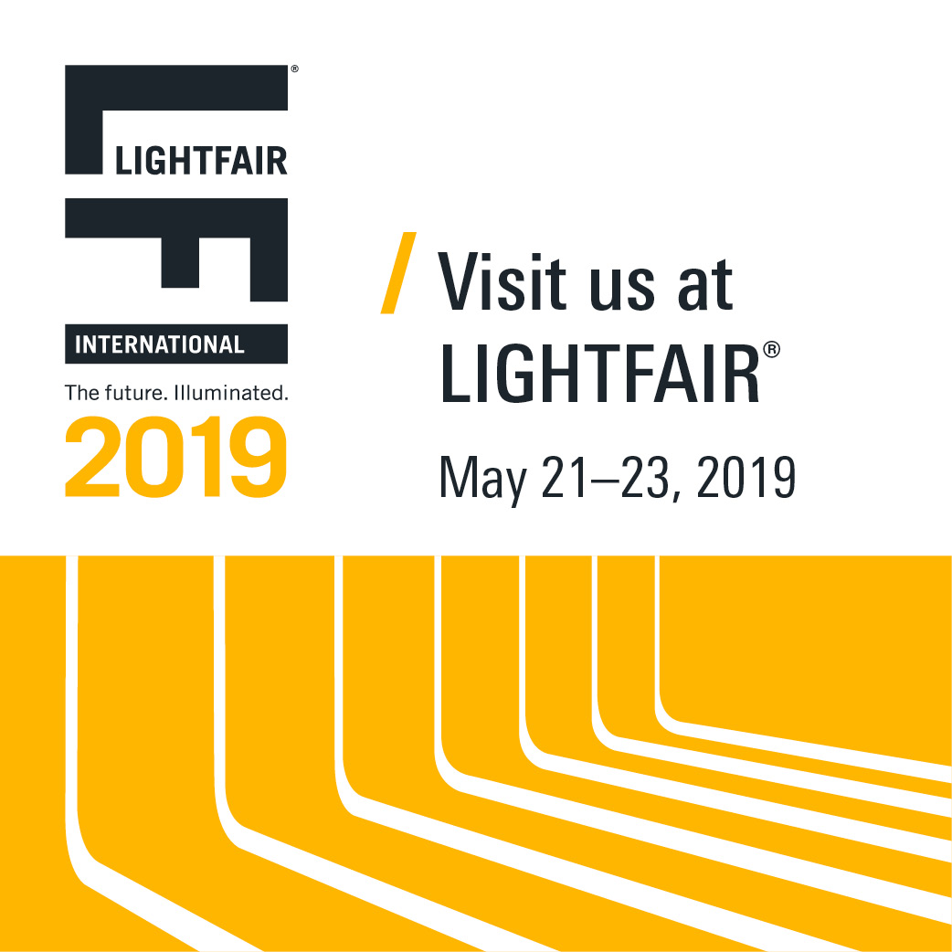
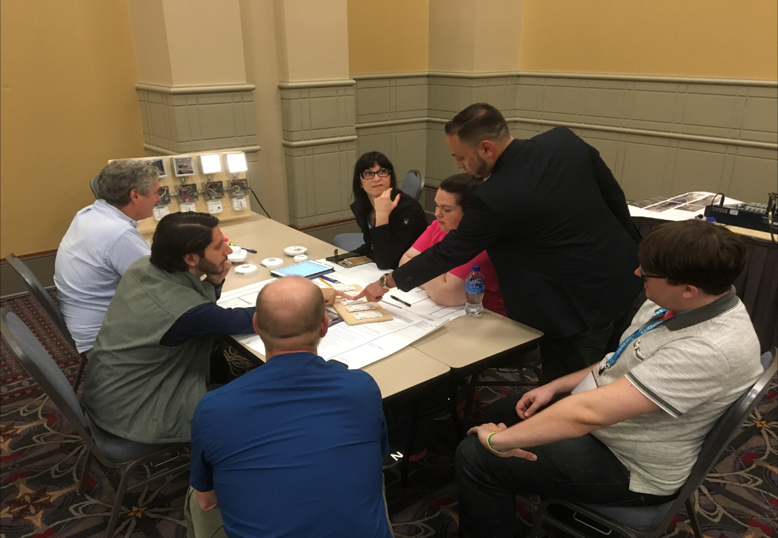
Courses Offered at LFI 2019

Slide 8
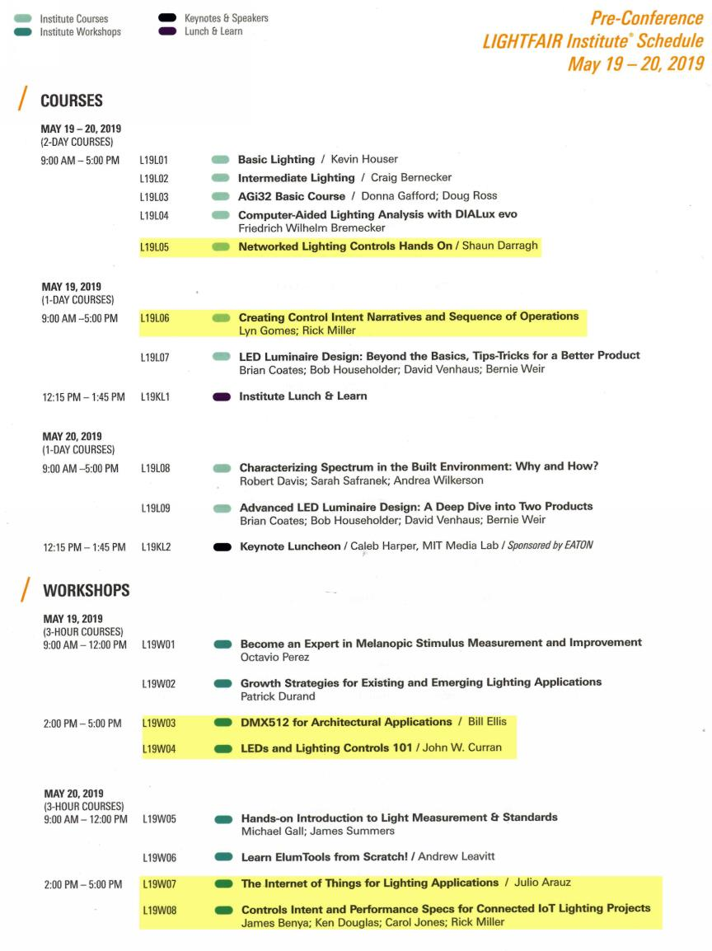
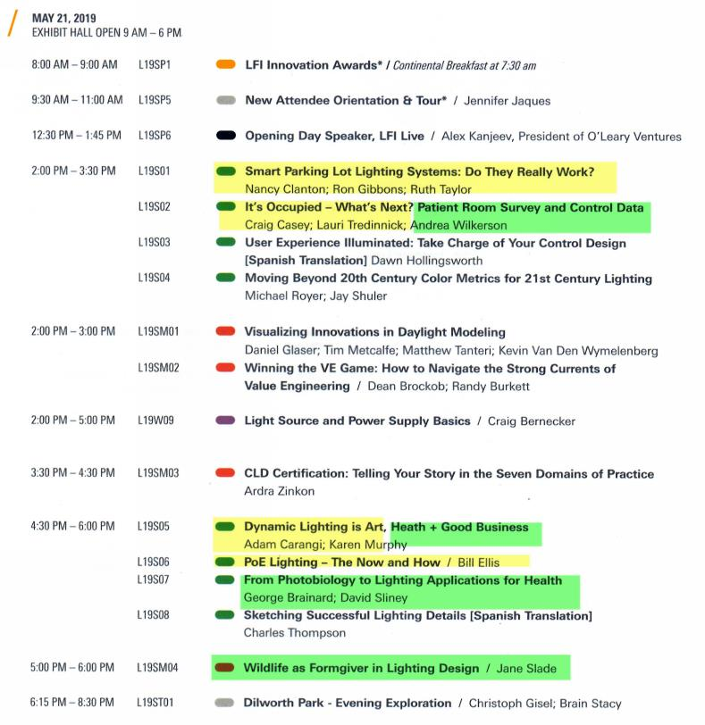
Courses Offered at LFI

Slide 9
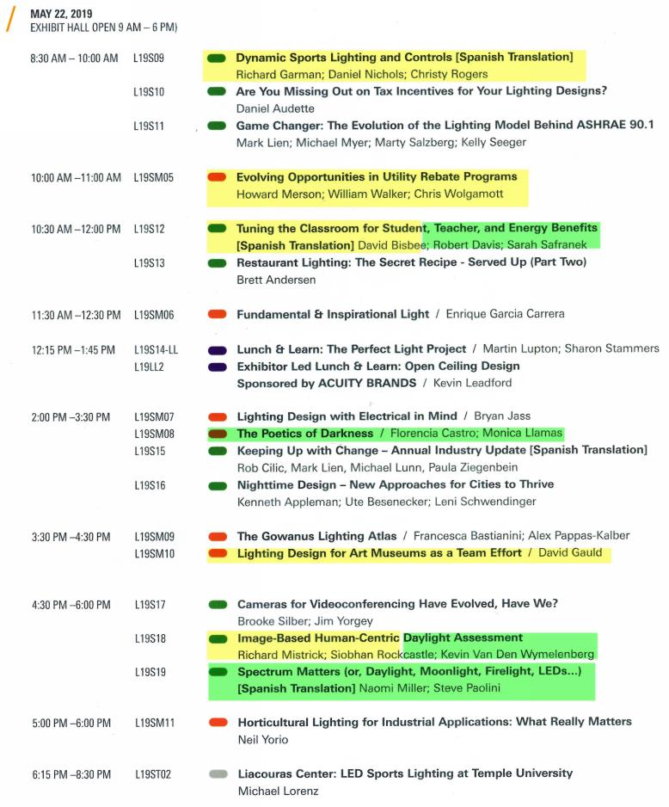
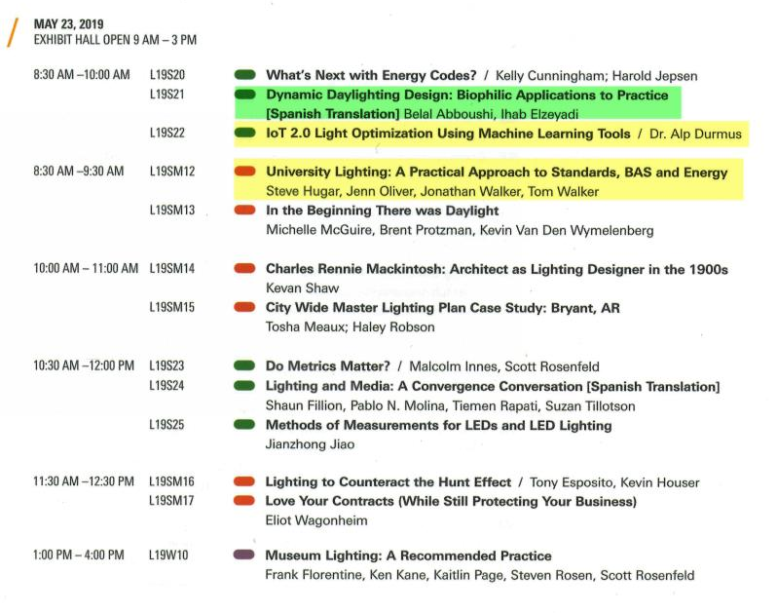
Courses Offered at LFI

Slide 10
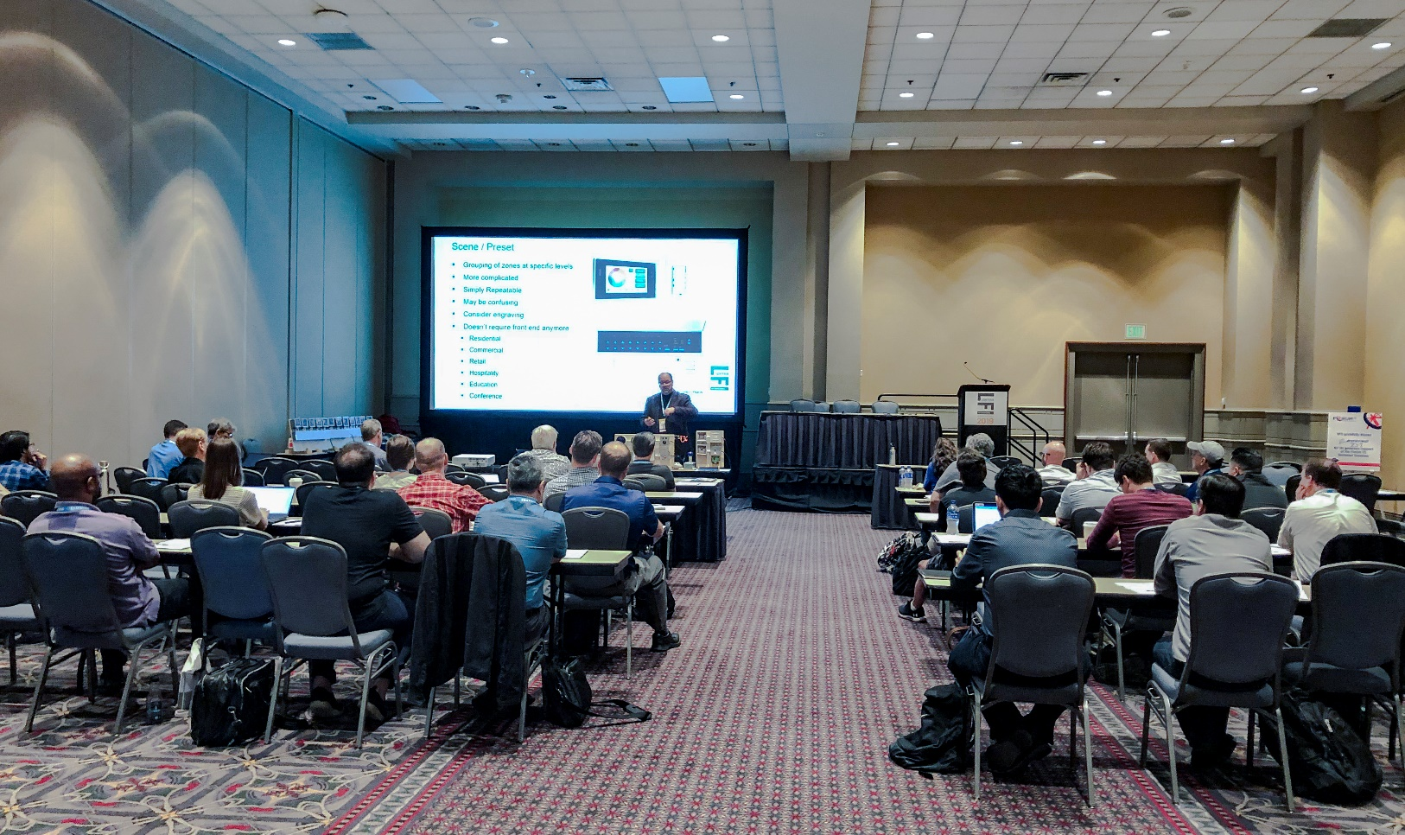
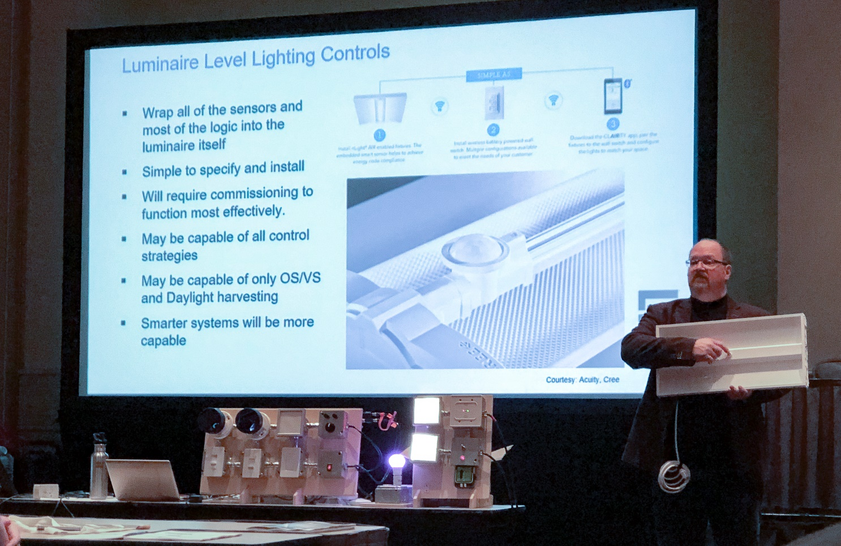
Lighting Design Lab: LFI Institute 2-day NLC Workshop
2 Day LightFair Institute Class
29 Students

Slide 11
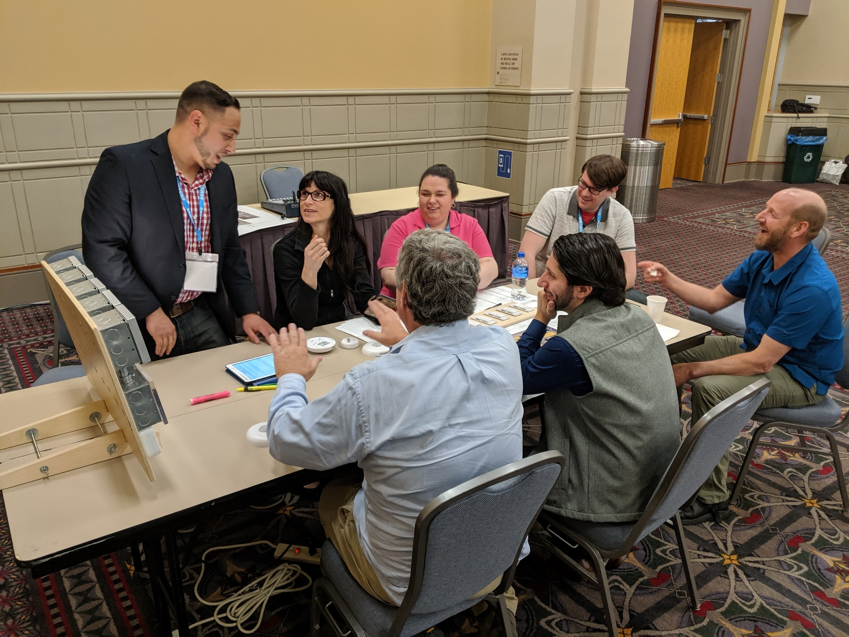
Lighting Design Lab: LFI Institute 2-day NLC Workshop
Who’s that guy stepping in to teach some of the system programming rotations?

Slide 12

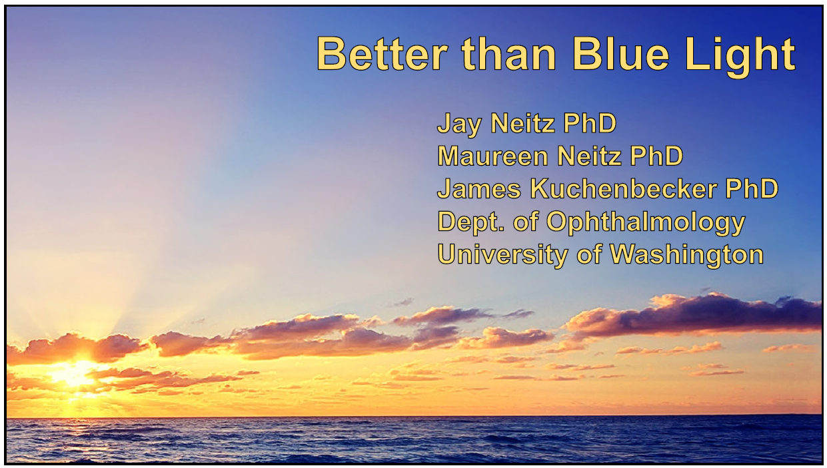
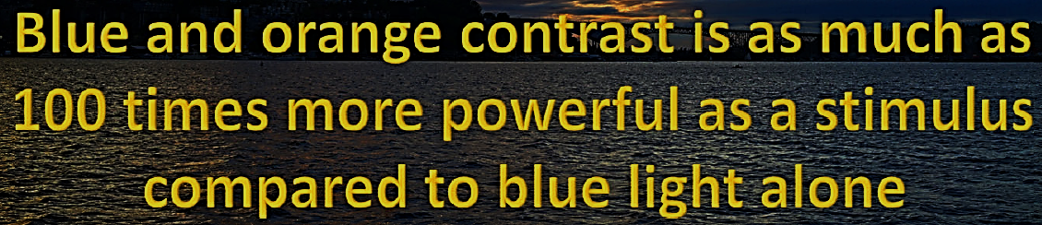

Slide 13
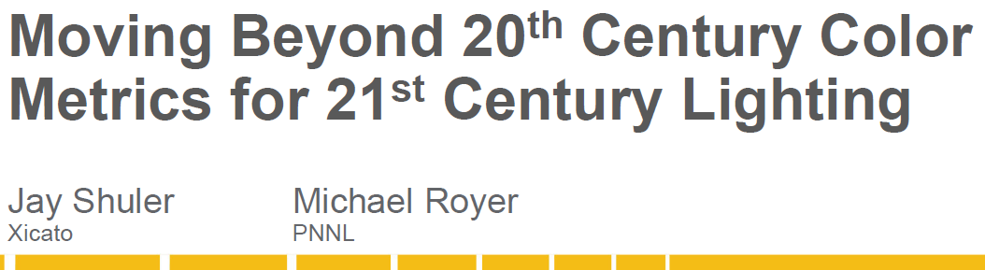
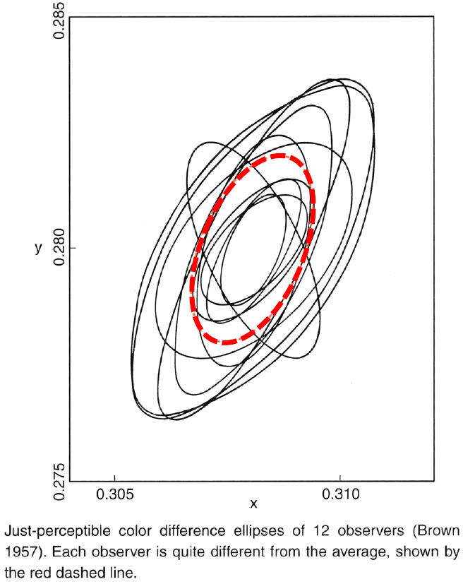
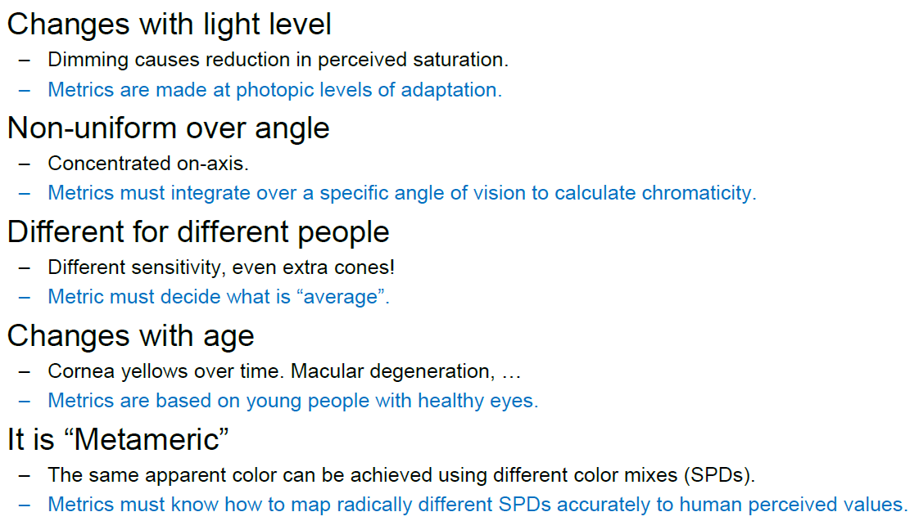
Quick Facts about Color Vision

Slide 14
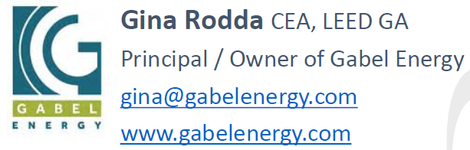
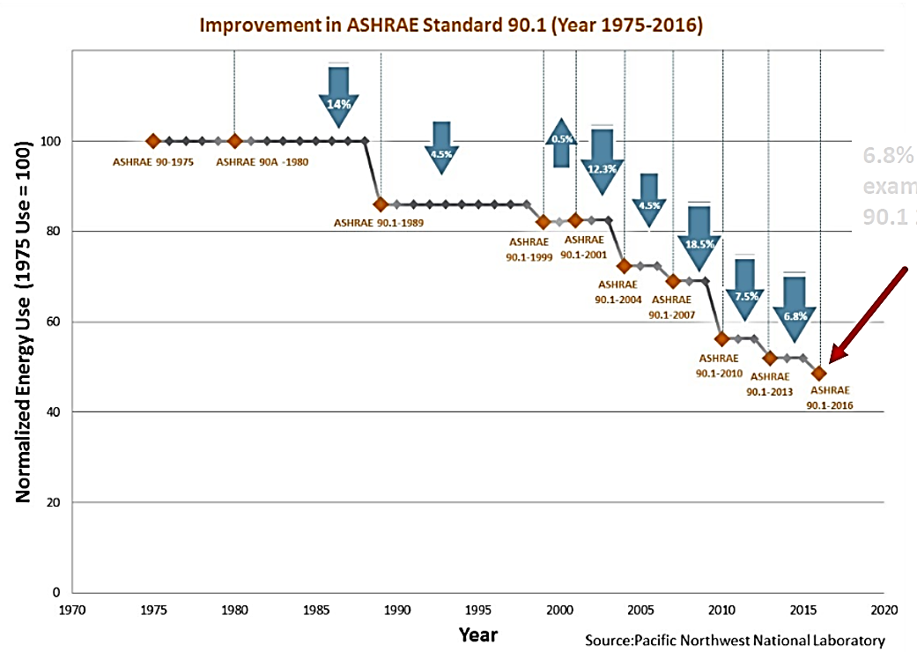
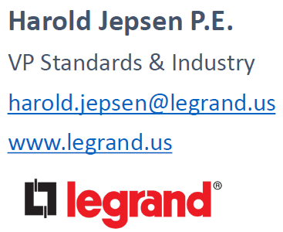

Slide 15
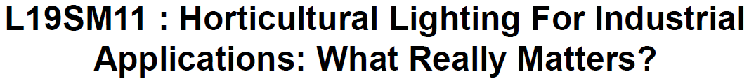
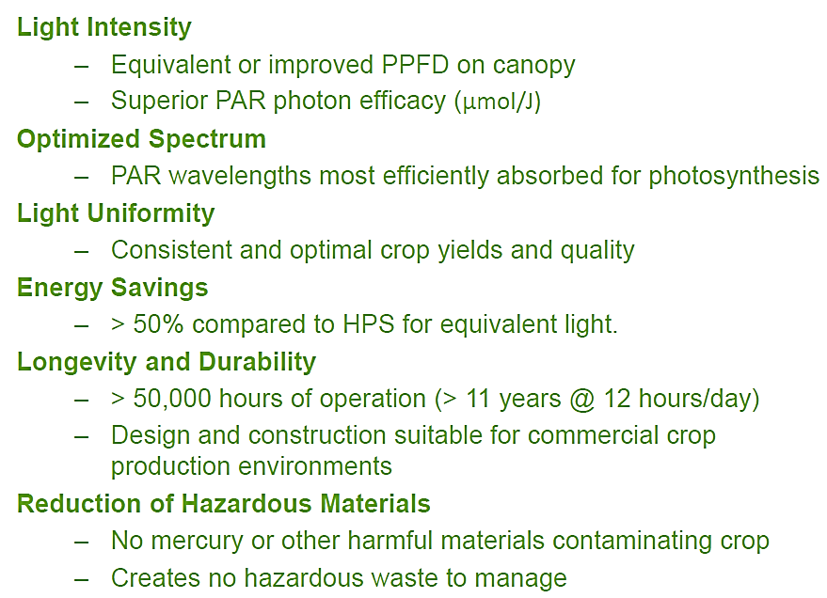
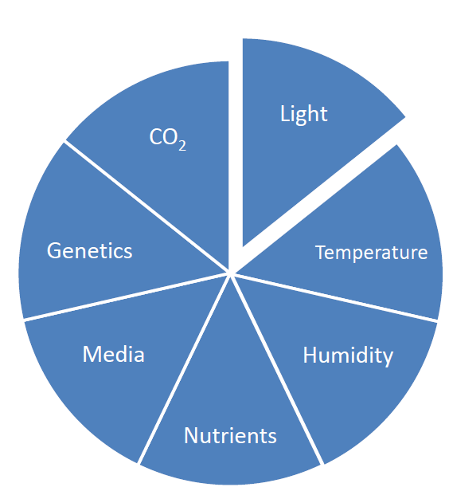
LED Technology Provides Improvements to Key Plant Lighting Parameters
Environmental Factors that Affect Plant Growth

Slide 16
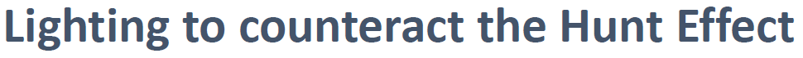
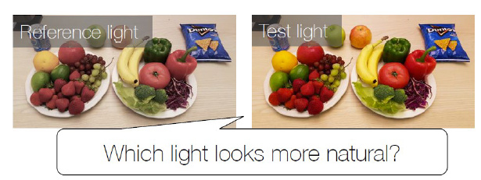
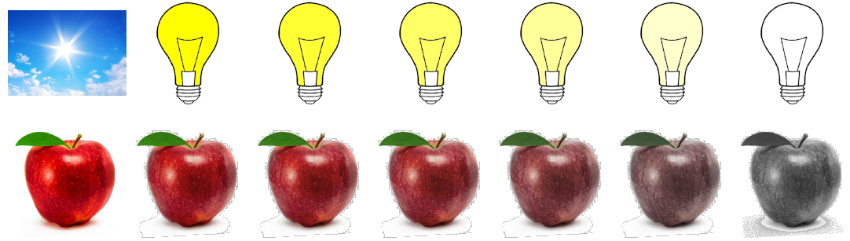
Tony Esposito, PhD
Head Research Scientist
Lighting Research Solutions LLC
EspositoT.research@gmail.com
Kevin Houser, PhD, PE, FIES, LC
Founder and CEO
Lyralux, Inc.
kevin.houser@lyralux.com
The Hunt Effect may be present even in our typical working/living environments!
• Slightly increased chroma may bring the perceived object colors close to those under outside daylight
• “The effect of chroma shift is not only for preference/naturalness issue but also an issue for color fidelity"

Slide 17
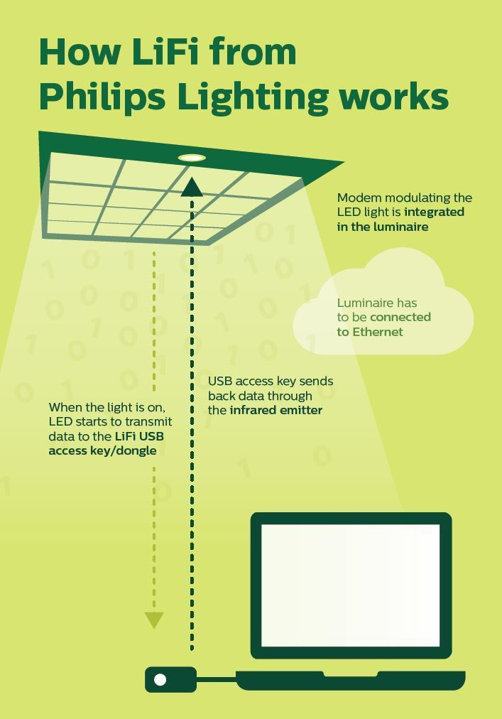
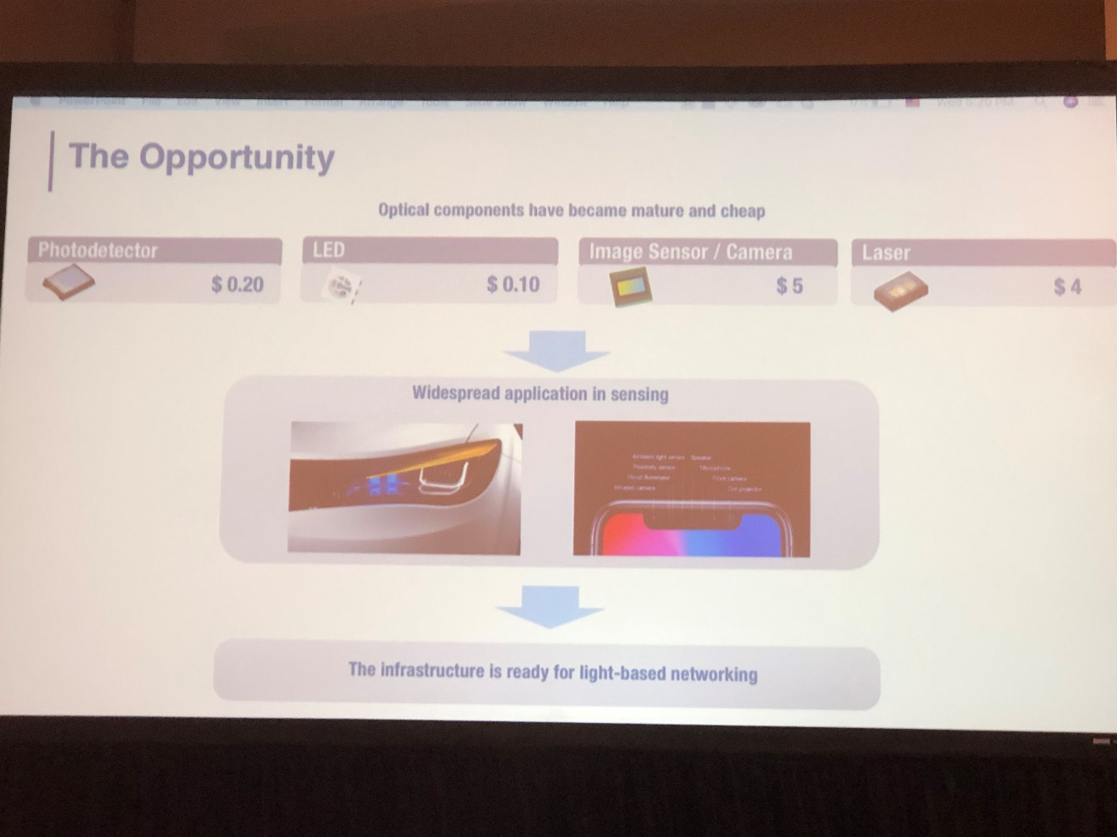
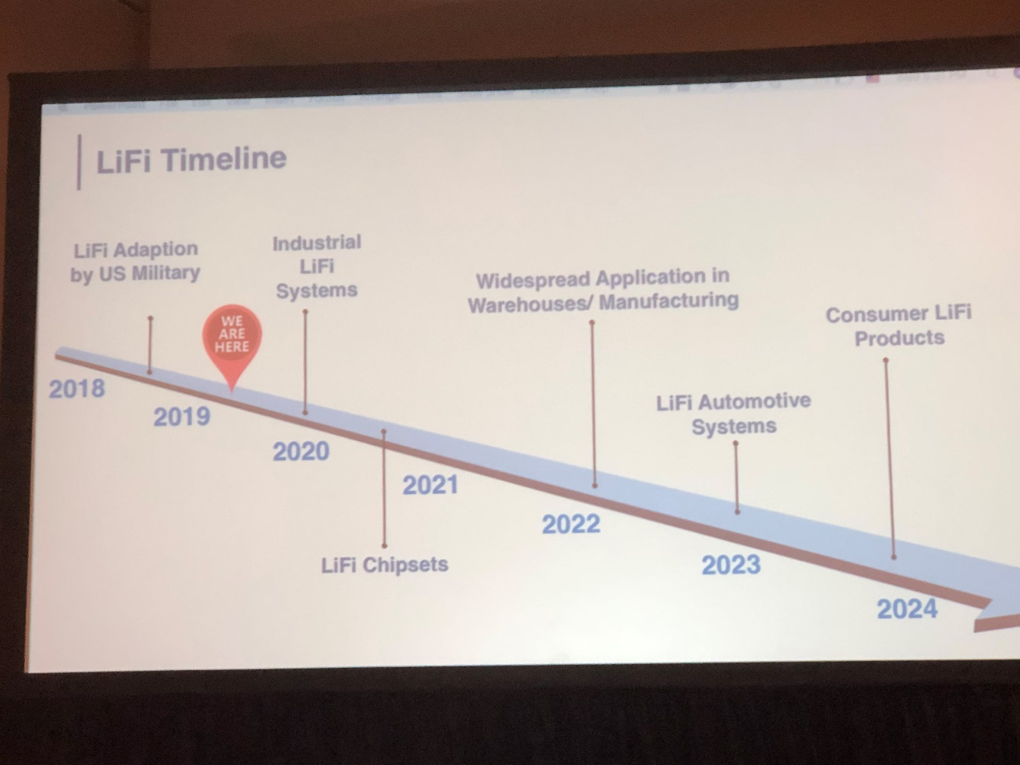
Light Fidelity *LiFi*
Notes:
Ab placeholder

Slide 18
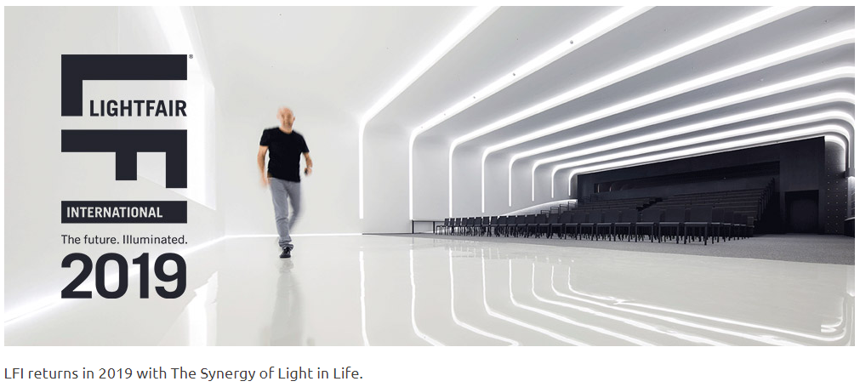
Trends from LFI – Interoperability

Slide 19
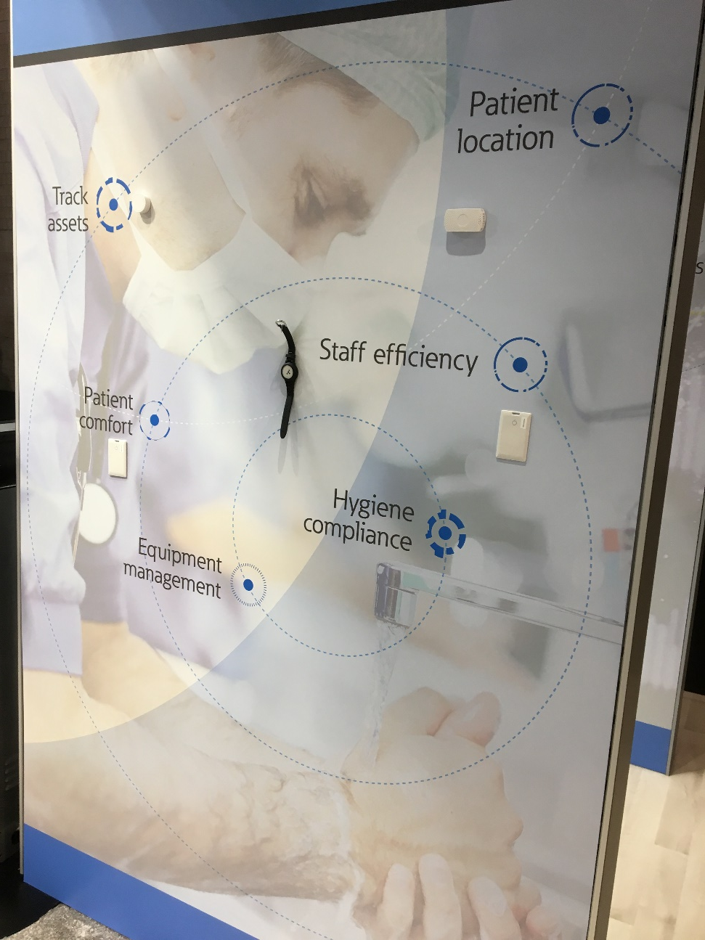
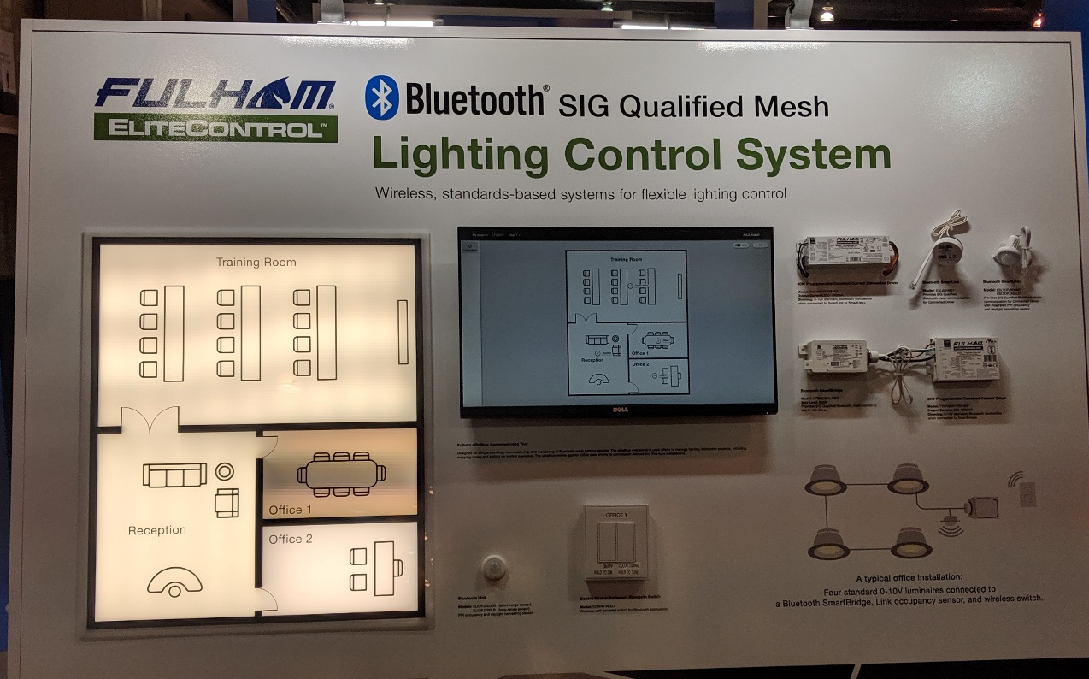
Trends in LightFair 2019… More Like… IoT Fair 2019
Classes…..displays….entire booths….IOT

Slide 20
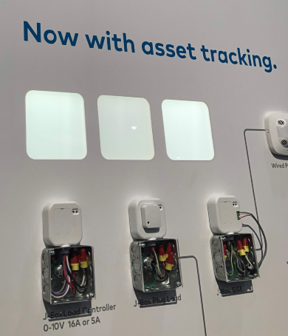
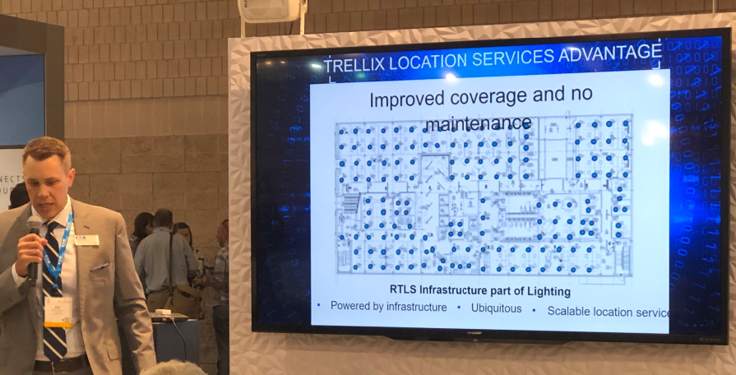
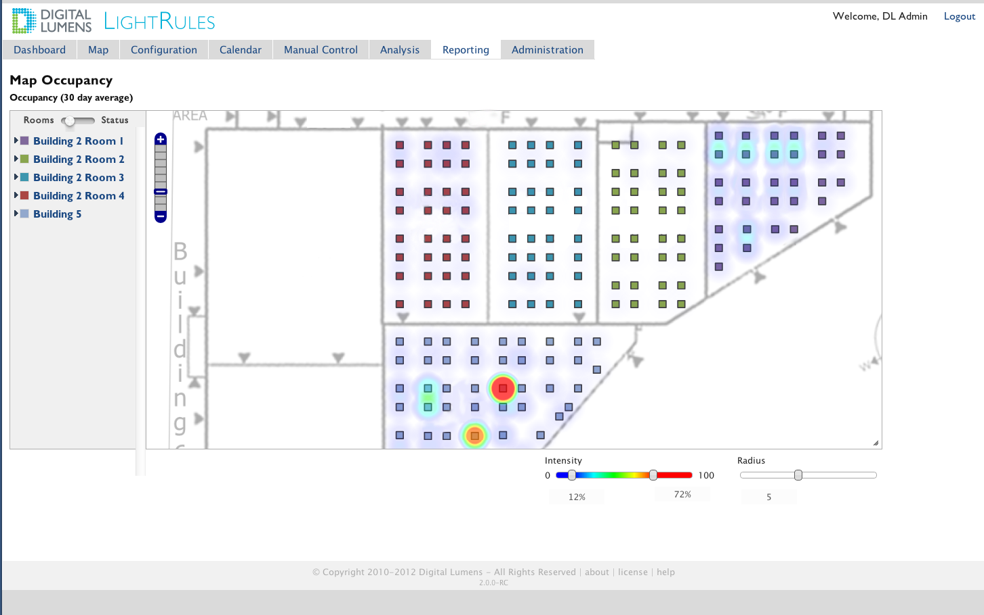
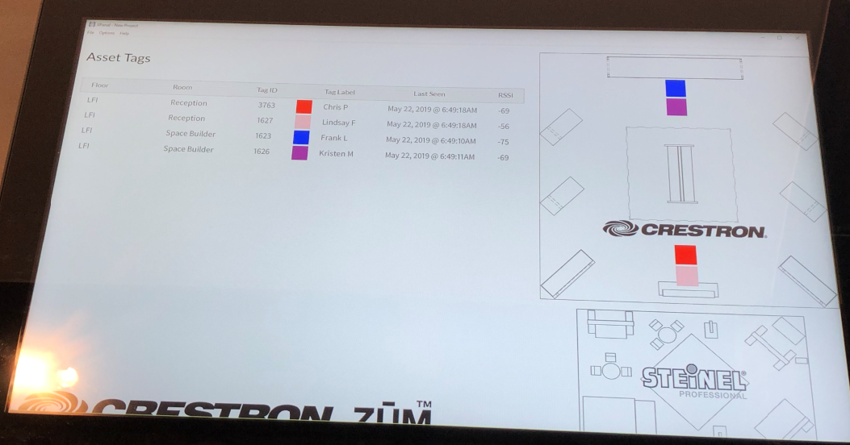
Non-Energy Benefits (NEB) – Asset Tracking

Slide 21
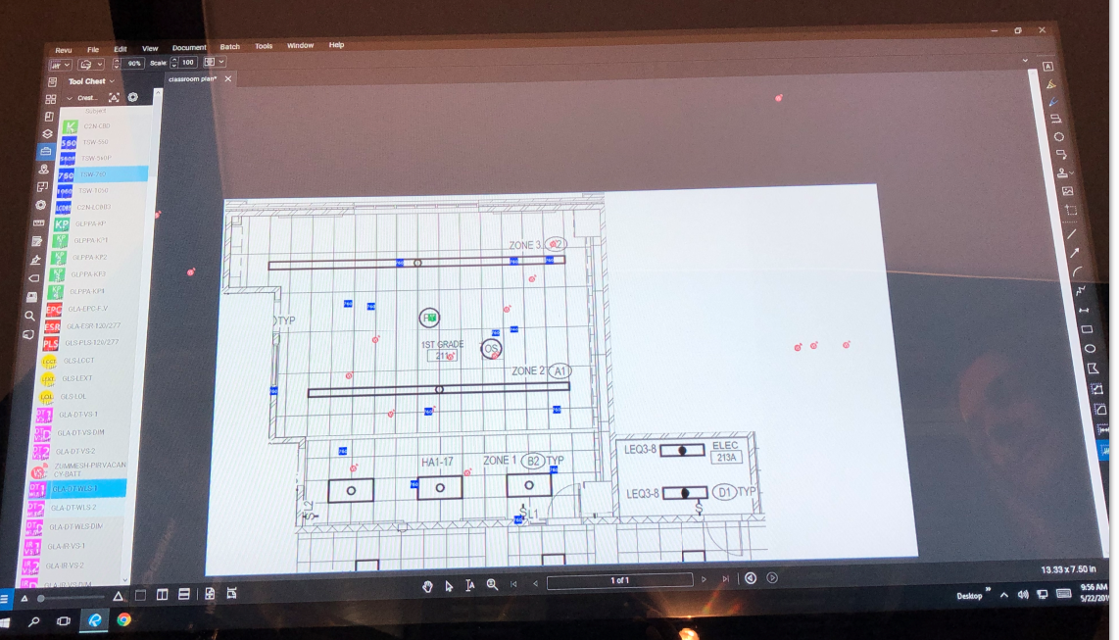
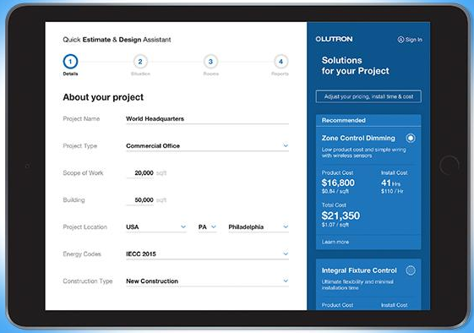
Design & Development Technology

Slide 22
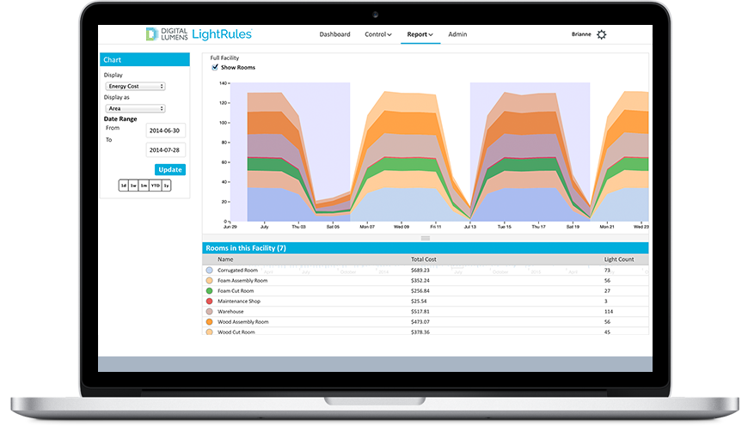
Dashing Dashboards

Slide 23
Trends from LFI – Light and Health

Slide 24
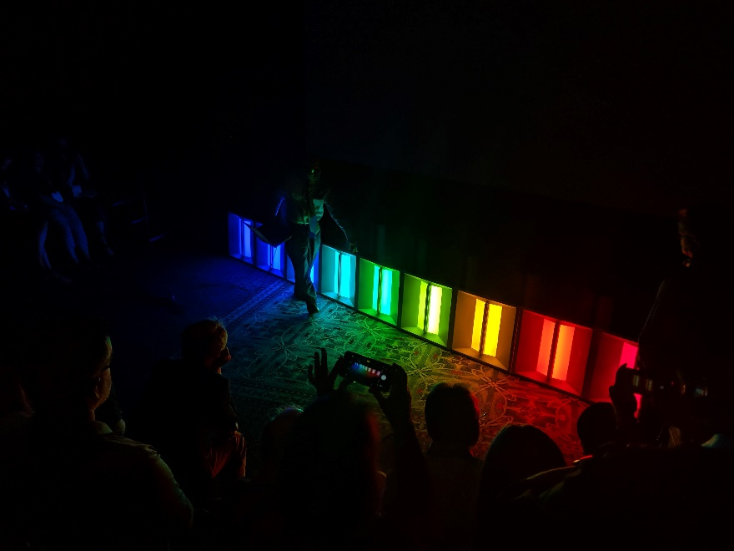
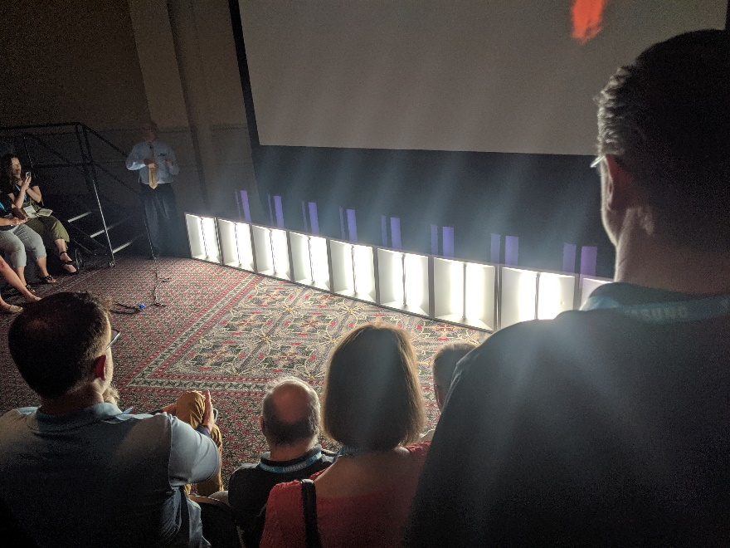
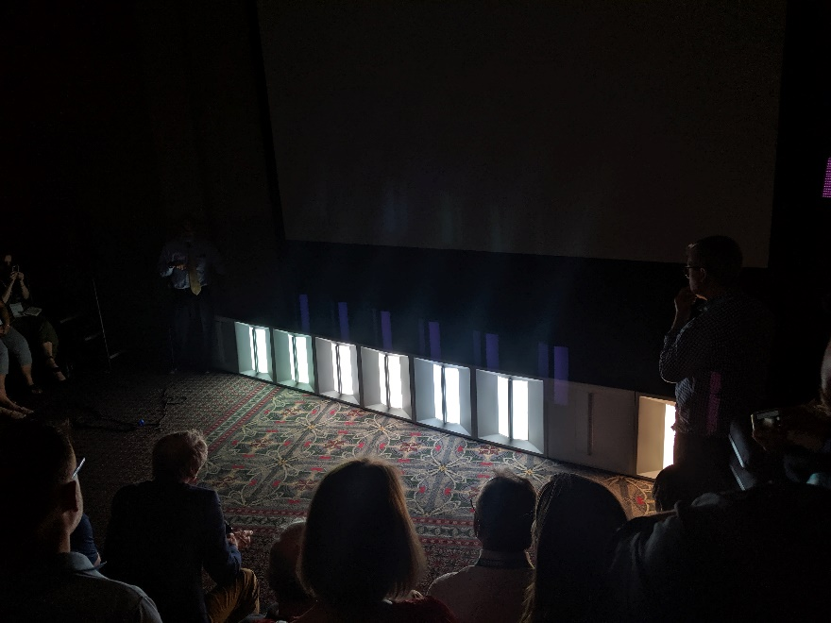
Trends from LFI 2019 – Light and Health
Spectral Power Distribution
Quality of Light
Controllability
Blue Light?

Slide 25
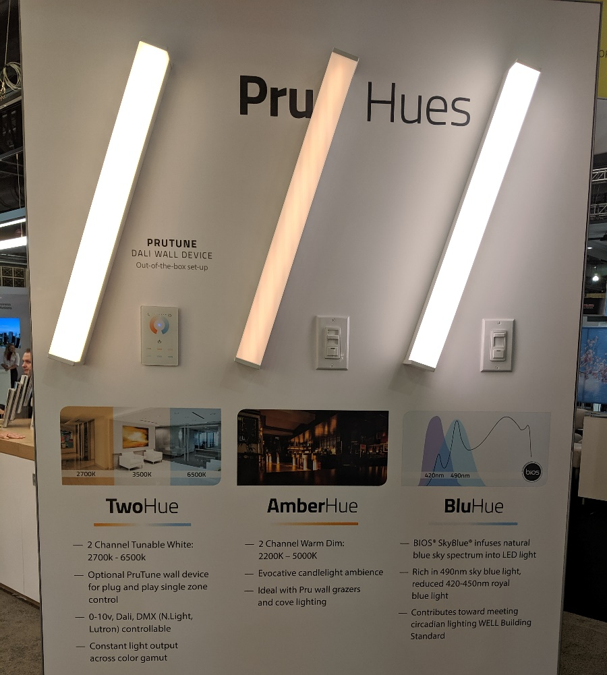
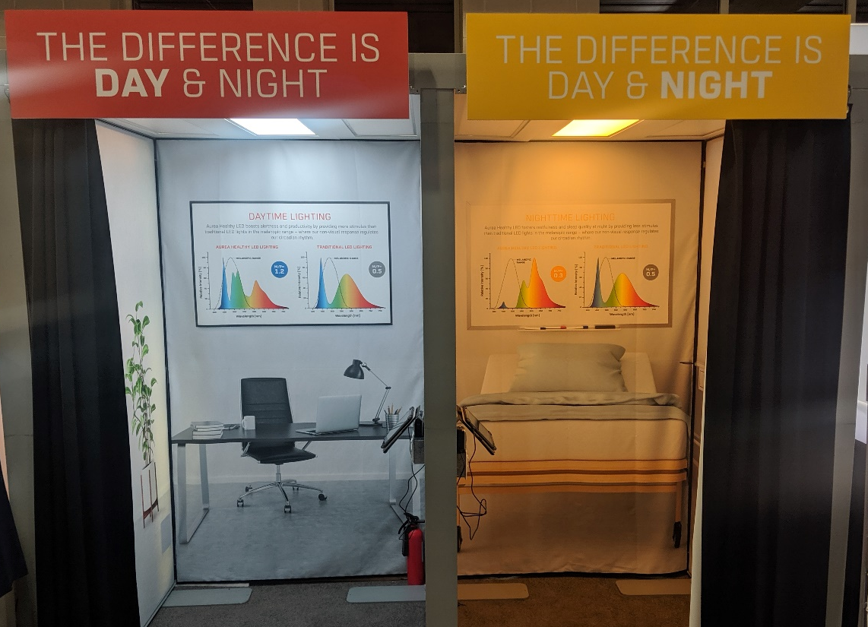
Trends from LFI 2019 – Light and Health
Circadian Entrainment
  Spectrum
  Intensity
  Duration
  Timing
  Direction
UL vs IES
Are we underlighting the daytime world?

Slide 26
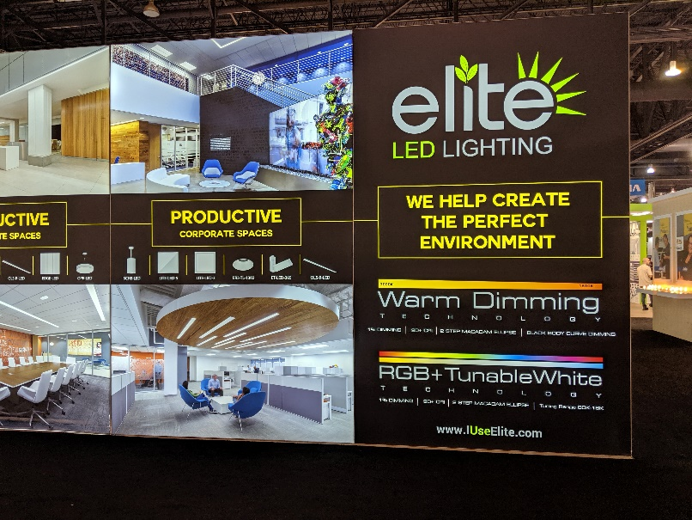
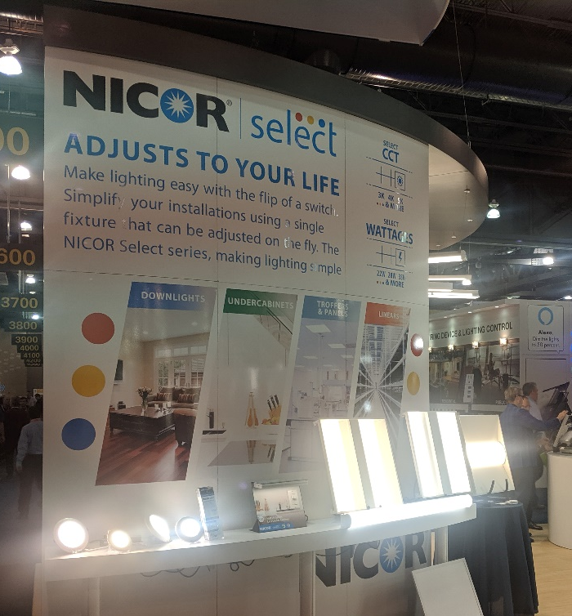
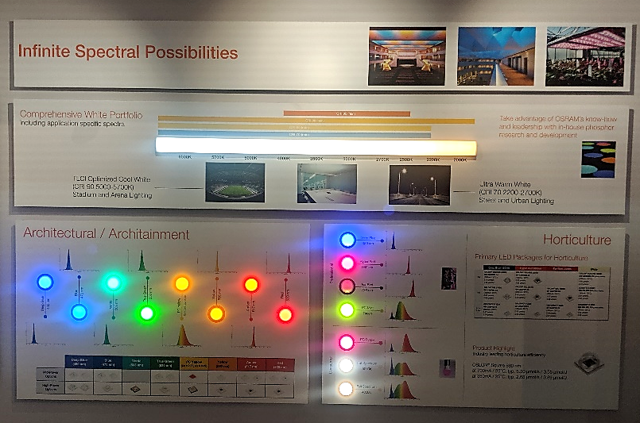
Trends from LFI 2019 – Light and Health
Spectral Tuning
  Tunable Color
  Tunable White
Blue pump / phosphor boards?
Narrow band emitter chip packages?
How long until most luminaires come standard with tunable white?
Non Energy Benefits for Controls

Slide 27





Trends from LFI 2019 – Light and Health AND IoT

Slide 28

LFI Innovation Award Winners
LFI
2019

Slide 29



Most Innovative Product
Lore is a fully adaptable luminaire family that features our newest optic & driver technology, engineered for precise beam performance and dimming. Every fixture in the Lore family includes power, light, optic, wireless, & battery backup building blocks, which means Lore provides consistent, predictable, performance from fixture to fixture across all fixture types. Lore also debuts EcoSense’s latest ‘Lingo’ digital platform architecture and Auto Sensing Protocol Technology, which makes Lore extremely flexible today & adaptable tomorrow.

Slide 30



Design Excellence
Renna has a simplicity of form provides compatibility with modern architecture, especially open and deconstructed ceilings. The 4” housing width and minimal 1/4” lightguide bezel supports a balance of visual comfort with a minimalist physical presence. Lightguide technology supports a low-profile 1” tall form while producing a uniform spread of luminance for both a glare-controlled downlight distribution and a concealed source asymmetric wall wash. Linear injection molded optics produce a performance indirect distribution for maximal uplight coverage, creating even illumination throughout the space.

Slide 31


Judges Citation
Nichia’s Color Tunable COB series is ideal for many applications, such as commercial, retail spot lights and residential downlights.
Retail stores can change the light color based on their display or objects in it.
Families will be able to change the color temperature of their home to best suit their natural biological rhythms.
Nichia’s color tunable COB expands the market potential for future lighting fixtures and environments.

Slide 32


Judges Citation
The E-series, achieves the industry-highest COB light efficacy of 140lm/W and the best color mixing. Unlike conventional methods, the E-series uses white and blue CSP chips and phosphor dispensing to improve light efficacy and color mixing by eliminating any interference between red and green phosphors. The white CSP chip emits high-efficiency warm white, while light emitted from the blue chip supplies cool white by passing through a dispensed phosphor.

Slide 33


It’s time for a new light source. A new approach that lays the groundwork for making brighter illumination possible.
LED has revolutionized the lighting industry, but fails to provide high luminance, directional lighting.
LaserLight is the solution with a seismic shift in the very definition of brightness.

Slide 34


Technical Innovation
The LaserLight MicroSpot Module (LLMS) is the world’s first 400 lumen module offering a 2 degree collimated beam from a 35mm optic. LLMS Module combines the highest luminance source, LaserLight SMD, with a TIR collimating secondary optic. The result is a compact module with very high candlepower intensity, narrow beam angle, sharp beam edge cutoff, and efficient beam shaping capabilities with diffusers. Module enables the development of micro luminaires with up to 1000m beam range by ANSI FL-1 spec. Applications include outdoor, architectural, entertainment, and security lighting.

Slide 35




** NEW ** Zhaga Consortium and DiiA Collaboration
Certification (Outdoor First)
Q3 2019
Multi-Vendor Product Interoperability
Notes:
The Zhaga Consortium (Zhaga) and the Digital Illumination Interface Alliance (DiiA) have unveiled their joint Zhaga-D4i certification program, indicating plug-and play interoperability of luminaires, sensors and communication nodes
Combining the expertise in the two organizations, the Zhaga-D4i certification program will enable smart, future-proof LED luminaires with IoT connectivity. Initially, the focus is on outdoor lighting, but indoor solutions are also in development.
The specifications cover all the critical features including mechanical fit, digital communication, data reporting and power requirements, ensuring plug-and-play interoperability of luminaires and nodes.
Old Zhaga
Standardized LED luminaire components & interfaces
New Zhaga
Standardize interoperable components for connected and serviceable lighting

Slide 36

Industry Engagement

Slide 37
Industry Engagement – What the Lab Said
Lighting Design Lab
Manufacturers
Rep Agencies
Equipment
Services
Sponsorships

Slide 38

Opportunities to Collaborate
Curriculum Involvement
Lighting Design Lab Space Demonstrations
Pilot Projects / Mock-ups / Case Studies
Speaking Engagements
Special Opportunity Projects
Notes:
Lighting Design Lab Space Demonstrations
Hundreds of visitors
Pilot Projects / Mock-ups / Case Studies
Exposure via 3rd party product
Special Opportunity Projects
Video Demonstration Microlearning's
Live product demonstrations to industry groups

Slide 39

Facility Demonstrations
Manufacturer
Product Name
Features & Characteristics
Where to find it
Mona With the Good Hair – Ld’V ca. 1503
Notes:
This one could be removed I believe.

Slide 40
Inclusive Advisory Committees
  Manufacturers
Technical Advisory Committee
  Energy Efficiency
  Orgs
  Utilities

Slide 41
End-Use Customers
Building Operators
Financial Incentives
Market Collateral
Design Support
Best Practice Guides
  Design-Bid-Build Market
New Construction &
Major Renovation
Design-Build Market
Retrofits &
Tenant Improvements
Hands on Learning
Trade Allies
Design Allies
Sales Training
CEUs
Notes:
This may not need to be here, but paints a great picture on who we serve and how unifying these markers increases the adoption of the tech

Slide 42

Industry Engagement – What The Lab Heard
Support from Industry
Desire to Sponsor the Lab
Affirmation of the need for LDL Core Services

Slide 43
Staff Favorites

Slide 44



Staff Favorites- Eric
The Glint Radian™ downlight has the remarkable ability to adjust beam direction up to 30° by a tiny shift of its optics, while the rest of the luminaire remains stationary. Simply slide the lens barrel in the direction you want the beam to move and novel Light Shift™ optics adjust beam direction without tilting the lamp or lenses. The beam remains perfect and non-occluded, while glare cut-off stays consistent. Advantages include:
1) a dramatic reduction in size (no bulky gimbals)
2) less glare (other spots can cast light into their enclosures or at your eyes)
3) a more harmonious look.

Slide 45



Staff Favorites- Eric
Lumadapt 8 LED sports lighting system allows operators to buy the features they need now and then remotely update and expand as needs change or new features become available. The smart cloud approach connects the entire system, providing expandability with a wide range of a-la-carte options including RGBA color, beam tuning, color temperature tuning, remote health monitoring, a dynamic scene builder and more.
Ephesus lights are optimized for HD, 4k, and even 8k broadcasts to deliver super-slow-motion replays without flicker and reproduce color more accurately

Slide 46





Staff Favorites - Shaun

Slide 47




Staff Favorites - Shaun

Slide 48



Staff Favorites - Shaun

Slide 49

Questions

Slide 50
Lighting Design Lab: Key Services & Resources
Lighting Classes (local, regional, & national)
Product Evaluation
Mockups
  Modeled, scaled and life-sized
Consultations
Online Resources
Publications
Energy Code Links
Event & Class Listings
Speaking Engagements
Lighting Demonstrations
500 sq ft Classroom Rental
Available for rent
Facility Tours
Networking Opportunities
  Open House
  Regional Meetings
  Industry Assoc. Memberships

Slide 51








Thank You to Our Partners

Slide 52
SBC/NEEC Outro Placeholder

Slide 53
Visit…Call…Click…Email…
lightingdesignlab@seattle.gov
www.lightingdesignlab.com
(206) 256-6161
800-354-3864
2915 - 4th Ave. South
Seattle, WA 98134
MISSION
Building business value through validation and education that drives adoption of energy-efficient lighting technologies and practices.

